Slide 1
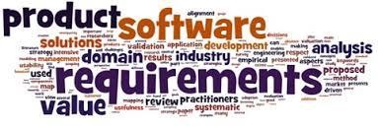
Software Requirement Engineering
Requirements Elicitation Techniques
Week # 7

Slide 2


Slide 3
A requirements development process framework
• Requirements development involves:
▫ Elicitation,
▫ Analysis,
▫ Specification, and
▫ Validation.
• In practice, these activities are interwoven, incremental, and iterative, as shown in Figure.

Slide 4
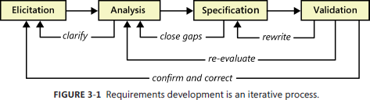
A requirements development process framework
• This iterative process continues throughout requirements development and possibly—as with agile projects—throughout the full project duration.

Slide 5
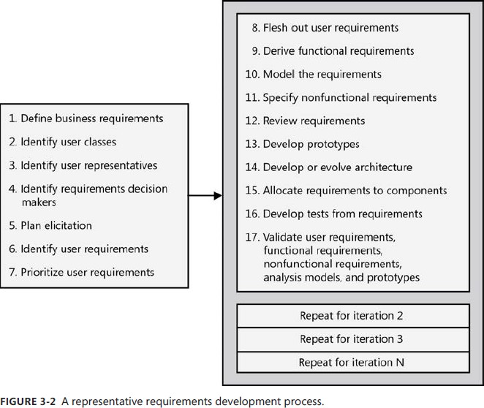

Slide 6
A representative requirements development process.
• Figure 3-2 suggests a process framework for requirements development that will work, with sensible adjustments, for many projects.
• The business need or market opportunity is the predecessor for the process shown in Figure 3-2.
• The first seven steps are typically performed once early in the project (although the team will need to revisit all of these activities periodically).

Slide 7
A representative requirements development process.
• The remaining steps are performed for each release or development iteration.
• Many of these activities can be performed iteratively, and they can be interwoven.
• For instance, you can perform steps 8, 9, and 10 in small chunks, performing a review (step 12) after each iteration.

Slide 8
Distribution of requirements development effort
• Figure 3-3 illustrates how some common software development life cycles allocate requirements effort across the product development period.
• The total requirements effort might not be much different for projects of comparable size that follow different life cycles, but the timing distribution of requirements work is very different.

Slide 9
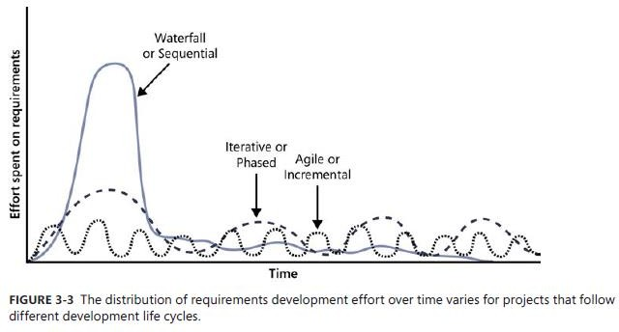
Distribution of requirements development effort

Slide 10
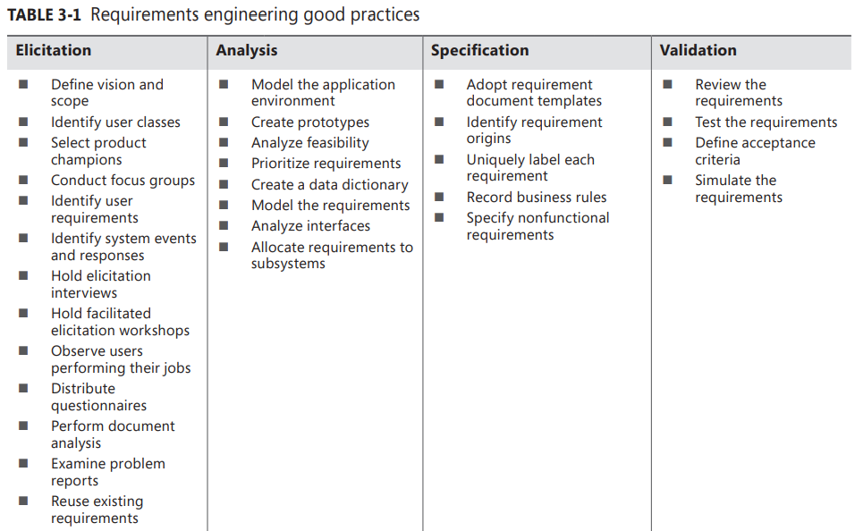

Slide 11
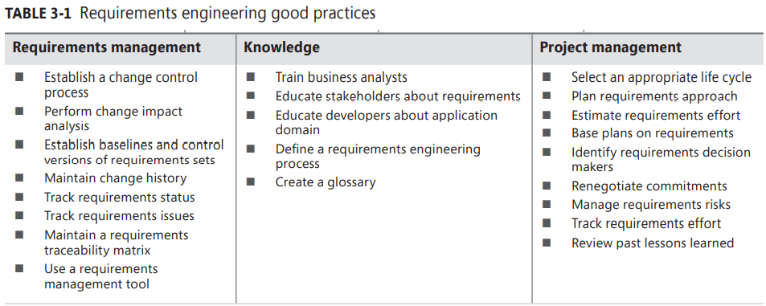

Slide 13
Good practices: Requirements elicitation
• Following are some practices that can help with eliciting the myriad types of requirements information:
▫ Define product vision and project scope:
🞄 The vision and scope document contains the product’s business requirements.
🞄 The vision statement gives all stakeholders a common understanding of the product’s outcome.
🞄 The scope defines the boundary between what’s in and what’s out for a specific release or iteration.
🞄 Together, the vision and scope provide a reference against which to evaluate proposed requirements.

Slide 14
Good practices: Requirements elicitation
▫ Identify user classes and their characteristics:
🞄 To avoid overlooking the needs of any user community, identify the various groups of users for your product.
🞄 They might differ in frequency of use, features used, privilege levels, or experience.
🞄 Describe aspects of their job tasks, attitudes, location, or personal characteristics that might influence product design.

Slide 15
Good practices: Requirements elicitation
▫ Select a product champion for each user class :
🞄 Identify an individual who can accurately serve as the literal voice of the customer for each user class.
🞄 The product champion presents the needs of the user class and makes decisions on its behalf.

Slide 16
Good practices: Requirements elicitation
▫ Conduct focus groups with typical users:
🞄 Convene groups of representative users of your previous products or of similar products.
🞄 Collect their input on both functionality and quality characteristics for the product under development.

Slide 17
Good practices: Requirements elicitation
▫ Work with user representatives to identify user requirements:
🞄 Explore with your user representatives the tasks they need to accomplish with the software and the value they’re trying to achieve.
🞄 User requirements can be expressed in the form of use cases, user stories, or scenarios.

Slide 18
Good practices: Requirements elicitation
▫ Identify system events and responses
🞄 List the external events that the system can experience and its expected response to each event. There are three classes of external events.
🞄 Signal events are control signals or data received from external hardware devices.
🞄 Temporal, or time-based, events trigger a response, such as an external data
feed that your system generates at the same time every night.
🞄 Business events trigger use cases in business applications.

Slide 19
Good practices: Requirements elicitation
▫ Hold elicitation interviews
🞄 Interviews can be performed one-on-one or with a small group of stakeholders.
🞄 They are an effective way to elicit requirements without taking too much stakeholder time because you meet with people to discuss only the specific requirements that are important to them.

Slide 20
Good practices: Requirements elicitation
▫ Hold facilitated elicitation workshops
🞄 Facilitated requirements-elicitation workshops that permit collaboration between analysts and customers are a powerful way to explore user needs and to draft requirements documents.
🞄 Such workshops are sometimes called Joint Application Design, or JAD, sessions

Slide 21
Good practices: Requirements elicitation
▫ Observe users performing their jobs
🞄 Watching users perform their business tasks establishes a context for their potential use of a new application.
🞄 Simple process flow diagrams can depict the steps and decisions involved and show how different user groups interact.
🞄 Documenting the business process flow will help you identify requirements for a solution that’s intended to support that process.

Slide 22
Good practices: Requirements elicitation
▫ Distribute questionnaires
🞄 Questionnaires are a way to survey large groups of users to determine what they need.
🞄 Questionnaires are useful with any large user population but are particularly helpful with distributed groups.
🞄 If questions are well written, questionnaires can help you quickly determine analytical information about needs.

Slide 23
Good practices: Requirements elicitation
▫ Perform document analysis
🞄 Existing documentation can help reveal how systems currently work or what they are supposed to do.
🞄 Documentation includes any written information about current systems, business processes, requirements specifications, competitor research, and COTS (commercial off-the-shelf) package user manuals.

Slide 24
Good practices: Requirements elicitation
▫ Examine problem reports of current systems for requirement ideas
Problem reports and enhancement requests from users provide a rich source of ideas for capabilities to include in a later release or in a new product.
Help desk and support staff can provide valuable input into the requirements for future development work.

Slide 25
Good practices: Requirements elicitation
▫ Reuse existing requirements
🞄 Projects often can reuse those requirements that comply with an organization’s business rules, such as security requirements, and requirements that conform to government regulations, such as accessibility requirements.
🞄 Other good candidates for reuse include glossaries, data models and
definitions, stakeholder profiles, user class descriptions, and personas.

Slide 26
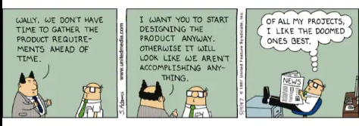

Slide 27
Requirements Elicitation
The heart of requirements development is elicitation, the process of identifying the needs and constraints of the various stakeholders for a software system. Elicitation is not the same as “gathering requirements.”
Elicitation is a collaborative and analytical process that includes activities to collect, discover, extract, and define requirements.
Elicitation is used to discover business, user, functional, and nonfunctional requirements, along with other types of information. Requirements elicitation is perhaps the most challenging, critical, error-prone, and communication-intensive aspect of software development.

Slide 28
Role of BA
The BA must create an environment conducive to a thorough exploration of the product being specified.
To facilitate clear communication, use the vocabulary of the business domain instead of forcing customers to understand technical jargon.
Record significant application domain terms in a glossary, rather than assuming that all participants share the same definitions.
Customers must understand that a discussion about possible functionality is not a commitment to include it in the product.
Brainstorming and imagining the possibilities is a separate matter from analyzing priorities, feasibility, and the constraining realities.

Slide 30
TECHNIQUES FOR GATHERING REQUIREMENTS
Brainstorming
Interview
Document Analysis
Focus Group
Interface Analysis

Slide 31
TECHNIQUES FOR GATHERING REQUIREMENTS
Observation/ Social Analysis
Prototyping
Workshops
Questionnaire Survey
Use cases and scenarios (UCD)
Reused Requirements

Slide 32
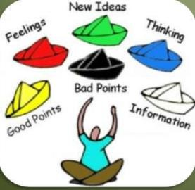
BRAINSTORMING
It is utilized in requirements elicitation to gather good number of ideas from a group of people.
Usually brainstorming is used in identifying all possible solutions to problems and simplifies the detail of opportunities.

Slide 33
BRAINSTORMING
BASIC RULES
1. Start out by clearly stating the objective of the brainstorming session.
2. Generate as many ideas as possible.
3. Let your imagination soar.
4. Do not allow criticism or debate while you are gathering information.
5. Once information is gathered, reshape and combine ideas.

Slide 34
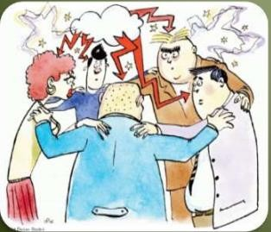
BRAINSTORMING
BENEFITS:
Generates a variety of ideas in a short time.
Produce new and creative ideas.
RISKS:
The risk of having a bad session
Making staff cared to voice their ideas because they were criticized in the session.

Slide 35
INTERVIEWS
The requirements engineer or analyst discusses the system with different stakeholders and builds up an understanding of their requirements
Interview Steps
Prepare
Conduct
Opening
Body
Closing
Follow through

Slide 36
INTERVIEWS
A few suggestions for conducting interviews follow
Establish rapport To begin an interview, introduce yourself if the attendees don’t already know you.
Stay in scope As with any elicitation session, keep the discussion focused on its objective.
Prepare questions ahead of time Prepare for interviews by drafting any materials you can beforehand, such as a list of questions to guide the conversation.
Suggest ideas Rather than simply transcribing what customers say, a creative BA proposes ideas and alternatives during elicitation.
Listen actively Practice the techniques of active listening (leaning forward, showing patience, giving verbal feedback, and inquiring when something is unclear)

Slide 37

ONE ON ONE INTERVIEW
The most common technique for gathering requirements is to sit down with the clients and ask them what they need. The discussion should be planned out ahead of time based on the type of
requirements you’re looking for.

Slide 38
ONE ON ONE INTERVIEW
BENEFITS:
Privacy of everyone
In-depth a stakeholder’s thoughts and get his or her perspective
RISKS & DRAWBACKS:
Time Consuming
Misunderstandings

Slide 39

GROUP INTERVIEW
If there are more then one person during interview usually 2 or 4 these people must be on some level must be on some level less time required.

Slide 40
GROUP INTERVIEW
BENEFITS:
We can get hidden requirements
Uncover a richer set of requirements in a shorter period of time
Uncover ambiguities
RISKS & DRAWBACKS
Not relaxed environment
Conflicts
The allotted time have been exhausted

Slide 41

DOCUMENT ANALYSIS
Document Analysis is an important gathering technique.
Evaluating the documentation of a present system can assist when making the current process documents.

Slide 42
DOCUMENT ANALYSIS
BENEFITS:
Validating the requirement completeness.
Chunks of information are mostly buried in present documents
A beginning point for documenting all current requirements.
RISKS & DRAWBACKS
Time Consuming
Conflicts
Exhausted
Not Found Real Figures

Slide 43

FOCUS GROUP
A focus group is actually gathering of people who are customers or users representatives for a product to gain its feedback.
The feedback can be collected about opportunities, needs, and problems to determine requirements or it can be collected to refine and validate the already elicited requirements.

Slide 44
FOCUS GROUP
BENEFITS:
Managed process with particular participants.
Refine and validate the already elicited requirements.
Allows analyst to rapidly obtain a wide variety of user views and possibly a consensus.
RISKS & DRAWBACKS
Following the crowd and some people think that focus groups are at best unproductive.
End up with is with least common denominator features.
Recruitment effort to Assemble groups. Dominant participants may influence group disproportionately

Slide 45
INTERFACE ANALYSIS
Interface for any software product will either be human or machine. Integration with external devices and systems is another interface.
The user centric design approaches are quite effective to ensure that you make usable software.
Interface analysis- analyzing the touch points with another external system- is vital to ensure that you do not overlook requirements that are not instantly visible to the users.

Slide 46
OBSERVATION OR SOCIAL ANALYSIS
Social analysis is also known as Observation.
Observation is the method of collecting requirements by observing the people doing their normal work.
This method is generally used to find the additional requirements needed by the user, when the user is unable to explain their expected requirements from the new product and problems with the existing product.

Slide 47

OBSERVATION OR SOCIAL ANALYSIS
BENEFITS:
The ability to record and report all findings that are true
It is more practical
No long calculation has to be done
RISKS & DRAWBACKS:
The viewer's or researcher's own perception
Few trials/studies/or objects observed to make an end conclusion and Results may contain human error

Slide 48
WORKSHOPS
Workshops can be efficient for gathering requirements.
The requirements workshops are more organized and structured than a brainstorming session where the involved parties get together to document requirements.
Creation of domain model artifacts like activity programs or static diagrams is one of the ways to capture the collaboration.
A workshop with two analysts is more effective than one in which on works as a facilitator and the other scribes the work together

Slide 49
WORKSHOPS
Following are a few tips for conducting effective elicitation workshops
Establish and enforce ground rules The workshop participants should agree on some basic operating principles.
Fill all of the team roles A facilitator must make sure that the following tasks are covered by people in the workshop
Plan an agenda Create the plan and workshop agenda ahead of time, and communicate them to participants
Stay in scope Refer to the business requirements to confirm whether proposed user requirements lie within the current project scope.
Keep everyone engaged Sometimes certain participants will stop contributing to the discussion. These people might be frustrated for a variety of reasons.
Timebox discussions Consider allocating a fixed period of time to each discussion topic.
Keep the team small but include the right stakeholders Small groups can work much faster than larger teams.

Slide 50
WORKSHOPS
BENEFITS:
group typically stays in the session until the session objectives are completed
participants stay in session until a
complete set of requirements
documented and agreed to
RISKS & DRAWBACKS
takes time to build
more costly to build
false sense of security

Slide 51
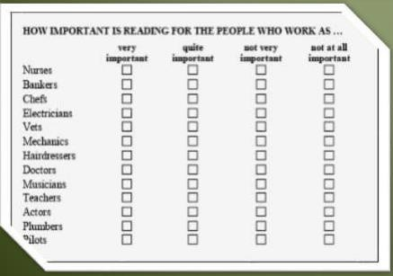
QUESTIONNAIRES
Questionnaires are much more informal, and they are good tools to gather requirements from stakeholders in remote locations or those who will have only minor input into the overall requirements.
Questionnaires can also be used when you have to gather input from dozens, hundreds, or thousands of people.

Slide 52
QUESTIONNAIRES
Tips for writing questionnaires are:
Provide answer options that cover the full set of possible responses.
Make answer choices both mutually exclusive.
Don’t phrase a question in a way that implies a “correct” answer.
If you use scales, use them consistently throughout the questionnaire.
Use closed questions with two or more specific choices if you want to use the questionnaire results for statistical analysis.
Consider consulting with an expert in questionnaire design and administration to ensure that you ask the right questions of the right people.
Always test a questionnaire before distributing it. It’s frustrating to discover too late that a question was phrased ambiguously or to realize that an important question was omitted.
Don’t ask too many questions or people won’t respond.

Slide 53
SURVEY
When gathering information from many people: to many to interview with time constraints and less budget: a questionnaire survey can be used. The survey insists the users to choose from the given options agree / disagree or rate something. Do not think that you can make a survey on your own but try to add meaningful insight in it. A well designed survey must give qualitative guidance for characterizing the market. It should not be utilized for prioritizing of requirements or features.

Slide 54
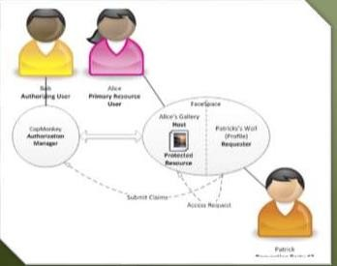
USE CASES AND SCENARIOS
Use cases are basically stories that describe how discrete processes work. The stories include people (actors) and
describe how the solution
works from a user perspective.
Use cases may be easier for
the users to articulate,
although the use cases may
need to be distilled later into the more specific detailed requirements.

Slide 55
PROTOTYPING
Prototyping is a relatively modern technique for gathering requirements.
In this approach, you gather preliminary requirements that you use to build an initial version of the solution — a prototype.
You show this to the client, who then gives you additional requirements.
You change the application and cycle around with the client again. This repetitive process continues until the product meets the critical mass of business needs or for an agreed number of iterations.

Slide 56
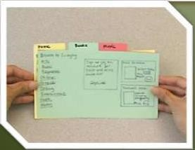
PROTOTYPING
BENEFITS:
Prototypes can be ideal reduce design risk
It is more practical
Screen mock-ups
Using animation tools
Provides an understanding of functionality
RISKS & DRAWBACKS
Takes time to build
More costly to build
False sense of security

Slide 57
REQUIREMENTS REUSE
In the field of software engineering reusing the requirements of the existing system is common method of requirements elicitation. Using the existing knowledge to develop the new product has many advantages that include low cost and less time. Though each product has their own type of stake holders and users, there is still number of situations that the reusing of the requirements take places

Slide 58
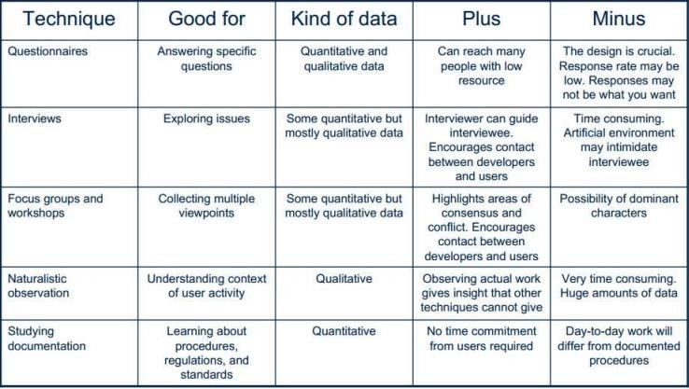
COMPARISION OF DATA GATHERING TECHNIQUES

Slide 59
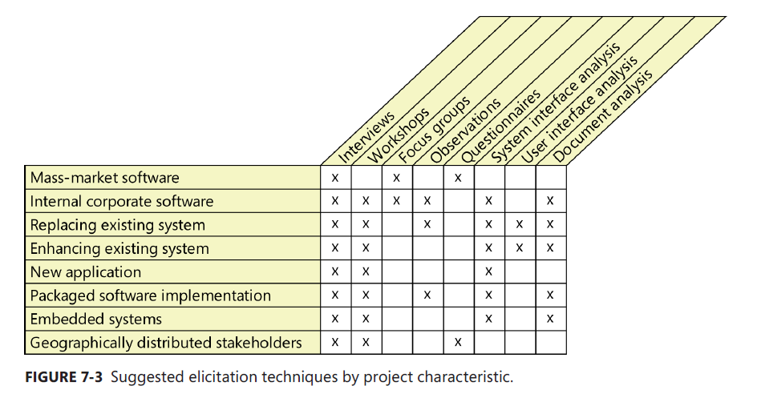
SUGGESTED ELICITATION TECHNIQUES

